Slide 1
Reinforcement Learning
Lecture 1
By:
Ms. Sara Rehmat

Slide 2
What is Reinforcement Learning?
The word “Reinforcement” refers to the act of strengthening or supporting something to make it stronger or more effective.
In Psychology, Reinforcement refers to a process in which a behavior is strengthened by the consequences that follow it.
Positive Reinforcement: Adding a reward to increase the likelihood of a behavior (e.g., giving praise for good performance).
Negative Reinforcement: Removing an unpleasant stimulus to encourage a behavior (e.g., reducing chores when homework is completed).
Reinforcement Learning is the most natural way to learn
Examples: child learning, pets training

Slide 3
What is Learning?
Artificial Intelligence:
Artificial Intelligence (AI) refers to the simulation of human intelligence in machines programmed to think, learn, and perform tasks that typically require human cognitive abilities.
Two main categories of AI
Learning by Rules (Rule-Based Systems):
Learning by Examples (Machine Learning)
Learning by Rules
Relies on explicitly programmed rules or logic defined by humans.
The system applies predefined rules to process input and produce output, often represented in if-then-else formats.
Examples of Use: Expert systems (e.g., MYCIN for medical diagnosis).
Limitations: Limited flexibility and adaptability; it cannot handle unforeseen scenarios or learn from new data without updating the rules.
Deduction based learning

Slide 4
What is Learning?
Learning by Examples:
Enables machines to learn patterns and behaviors from data or examples instead of being explicitly programmed.
It uses statistical methods and algorithms to infer relationships and make predictions.
Examples of Use: Image recognition (e.g., identifying objects in pictures), Natural language processing (e.g., chatbots, translation).
Induction based learning
Subcategories:
Supervised Learning: Learning from labeled data.
Unsupervised Learning: Finding patterns in unlabeled data.
Reinforcement Learning: Learning through trial and error with feedback.

Slide 5
Reinforcement Learning
In Reinforcement Learning, reinforcement refers to the feedback (rewards or penalties) that an agent receives as it interacts with its environment, guiding it to improve its decisions or behavior.
An agent in Artificial Intelligence (AI) is an autonomous entity that perceives its environment, makes decisions based on that perception, and takes actions to achieve specific goals or objectives.

Slide 6
Goal / reward?
A reward is a numerical signal that provides feedback to an agent about the success of its actions in achieving a desired goal. The reward guides the agent to learn behaviors that maximize the total reward over time.
Goal is maximizing the total reward (cumulative reward) over time.
Rewards provide immediate feedback about whether the agent's actions are beneficial (moving it closer to the goal) or detrimental (moving it away from the goal).
The agent learns the optimal behavior (policy) to achieve the goal by maximizing the rewards over time.
All goals can be described by the maximisation of expected cumulative reward (reward hypothesis).

Slide 7
Difference between Supervised and Reinforcement Learning
Task | Supervised Learning | Reinforcement Learning
Playing Chess | Train on a dataset of past chess games labeled with the winning move sequences. | Learn to play by trial and error, with rewards for winning games or making advantageous moves
Recommender Systems | Predict user preferences using labeled data (e.g., ratings for movies or products). | Recommend items and adjust recommendations based on real-time user feedback and interactions.
Autonomous Driving | Train a model using pre-recorded driving data labeled with correct actions (e.g., steering angles, braking). | Train the car to drive by interacting with a simulated environment, receiving rewards for safe and efficient driving.

Slide 8
Characteristics of Reinforcement Learning
There is no supervisor, only a reward signal
Feedback is delayed, not instantaneous
Time really matters (sequential)
Agent’s actions affect the subsequent data it receives

Slide 9
Sequential Decision Making
Goal: select actions to maximise total future reward
Actions may have long term consequences
Reward may be delayed
It may be better to sacrifice immediate reward to gain more long-term reward
Examples:
A financial investment (may take months to mature)
Refuelling a helicopter (might prevent a crash in several hours)
Blocking opponent moves (might help winning chances many
moves from now)

Slide 10
Examples of Reinforcement Learning
Fly stunt manoeuvres in a helicopter
Defeat the world champion at Backgammon
Manage an investment portfolio
Control a power station
Make a humanoid robot walk
Play many different Atari games better than humans

Slide 11
Examples of rewards
Fly stunt manoeuvres in a helicopter
+ve reward for following desired trajectory
−ve reward for crashing
Defeat the world champion at Backgammon
+/−ve reward for winning/losing a game
Manage an investment portfolio
+ve reward for each $ in bank
Control a power station
+ve reward for producing power
−ve reward for exceeding safety thresholds
Make a humanoid robot walk
+ve reward for forward motion
−ve reward for falling over
Play many different Atari games better than humans
+/−ve reward for increasing/decreasing score

Slide 12
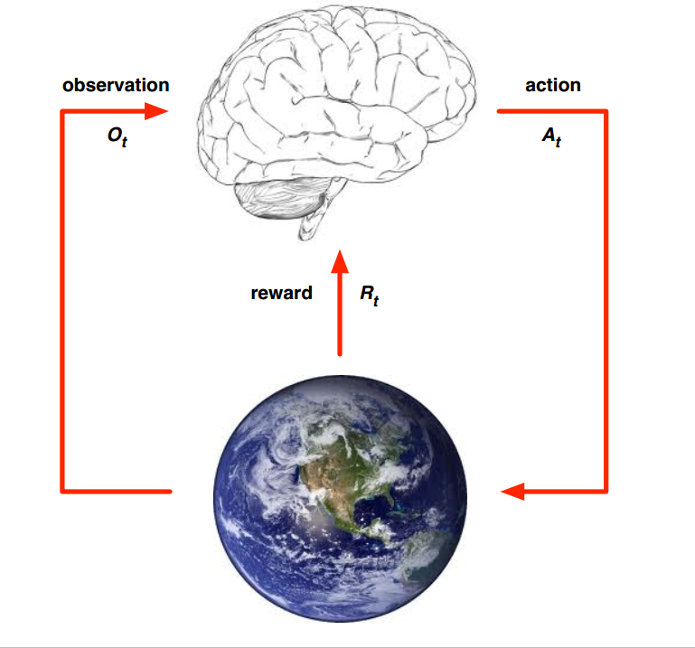
Agent and Environment
At each step t the agent:
Executes action A_{t}
Receives observation O_{t}
Receives scalar reward R_{t}
The environment:
Receives action A_{t}
Emits observation O_{t+1}
Emits scalar reward R_{t+1}
t increments at env. step

Slide 13
Applications of Reinforcement Learning
Reinforcement Learning in classical gaming
Reinforcement Learning in robotics
Reinforcement Learning in recommender systems
Reinforcement Learning in video games
Reinforcement Learning in recommender systems

Slide 14
Reinforcement Learning frameworks
Library/Framework | Description
OpenAI/Gym (Gymnasium) | A standard framework for developing and comparing RL algorithms with a collection of simulation environments.
Keras-RL | High-level RL implementations in Keras for quick prototyping.
PyTorch RL | RL-specific implementations in PyTorch, offering flexibility for custom models.
Acme | A library by DeepMind for building RL agents with modular and research-oriented components.
TF-Agents | TensorFlow-based library for RL, providing modular components for building custom RL algorithms.

Slide 15
Reinforcement Learning frameworks
Library/Framework | Description
Unity-ML agents | A platform to train RL agents in Unity environments, suitable for 3D simulations and games.
CARLA | Open-source autonomous driving simulator for RL research.
AirSim | A simulator for drones, cars, and robotics developed by Microsoft for RL and computer vision.
Mujoco | Physics engine for robotics and continuous control environments, often used in RL tasks.
PyBullet | Open-source physics simulator with robotics environments for RL.

Slide 16
Controlling 3D gaming agent in an adversarial setting with deep reinforcement learning
Anylog
Dynamic traffic lights management system
Controlling 3D gaming agent in an adversarial setting with deep reinforcement learning

Slide 17
FYPs

